Slide 1
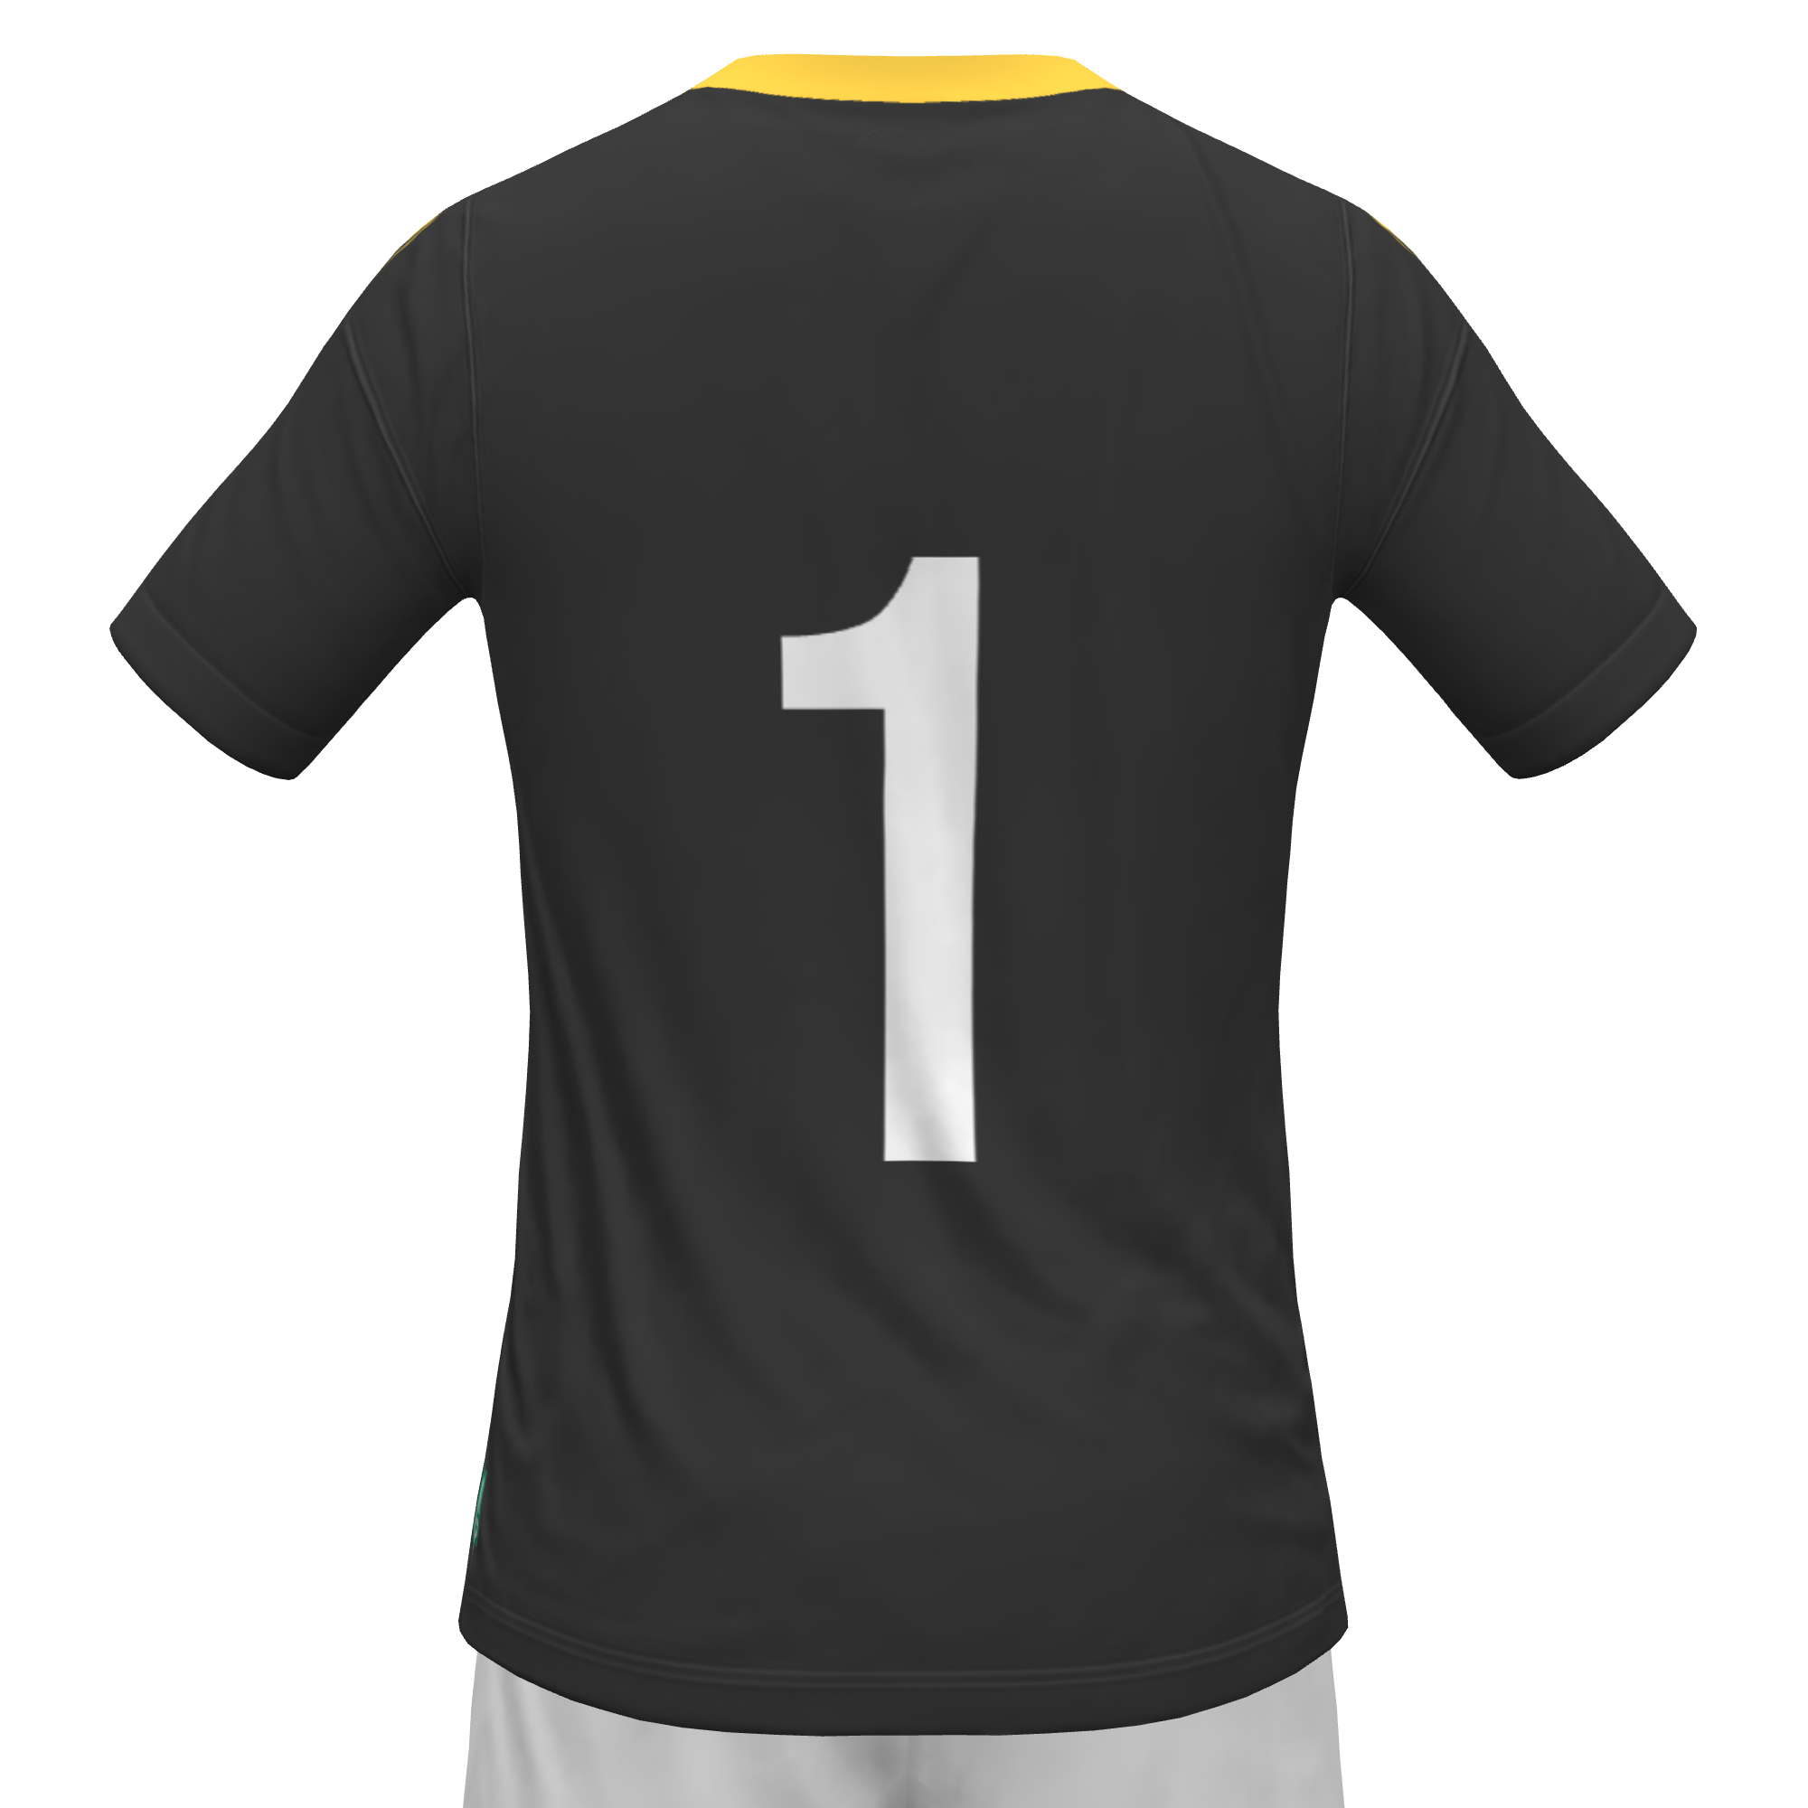
9
11
7
10
8
6
5
2
4
3
1

Slide 3
Kernwaarden —> Voetbal:
“Strijders Die spelen om te winnen en die elke dag beter willen worden”
Speelstijl
Profielen & Begrippen
KPI 1: Top-3 goals (6th)
KPI 2: Top-3 challenge intensity (10th)
KPI 3: Top-3 doelpogingen(12th)
Scouting
IDP
Goal 1
Goal 2
Goal 3
Transfer target: +€750K
transfers: >1M
KKD: Top 10
10e positie in de KKD
Academy players: 50%*
Competitieminuten: 38%
**Minimaal 3 jaar in de academy
(Stan, Mees, Kevin, Danny, Nick, Sheddy, TJemme, Ilias)

Slide 4

Browse
Foto
DATE: DD-MM-JJJJ
Player name
DD/MM/YYYY: Game / Training
DD/MM/YYYY: Game / Training
DD/MM/YYYY: Game / Training
DD/MM/YYYY: Game / Training
DD/MM/YYYY: Game / Training
DD/MM/YYYY: Game / Training
DD/MM/YYYY: Game / Training
xx
xx%
Handling
Prevention vs defending
Distribution
Agility
Bravery
Consistency
xxxx
GOALKeeper #01
9
11
7
xxxx
8
10
6
xxxx
xx
xx
xx
xx
5
2
4
3
xxxx
1
xxxx

Slide 5
GK | Rating | Multiplication factor | Result
Handling | 0 | 1,1 | 0
Prevention vs defending | 0 | 1,1 | 0
Distribution | 0 | 1 | 0
Agility | 0 | 1,1 | 0
Bravery | 0 | 1,1 | 0
Consistency | 0 | 1 | 0
 |  | Average rating | 0,00

Slide 6
Goalkeeper #01
9
11
7
Handling
Agility
Bravery
10
8
Prevention vs defending
6
5
2
4
3
Distribution
Consistency
1

Slide 7
Handling
Prevention vs defending
Distribution
Agility
Reading, anticipating and reacting to 1v1 situations, dealing with through balls and crosses.
“Quickly change direction, accelerate, and control body movement while maintaining balance”
“Defending a lot of balls
Kicking, passing and throwing
Inside 16m
Outside 16m
One on ones
Set pieces
Positioning
Frequency
End result
?
Positioning
Coaching
Decision making
Follow-up
Timing
Frequency
End result
?
Speed of actions
Type of pass
Both legs
Direction & timing
Pace & height
Preparation
Frequency?
End result
?
Reaction speed
Footwork
Balance
Center of gravity
Change of direction
Mobility
?
Bravery
Consistency
“The willingness to face physical challenges, difficult situations, or potential contact without fear”
“Perform at a similar level of quality repeatedly over time, across matches or actions”
Initiative
Taking risks
Freedom
Surprising
Creativity
Confident after mistakes
?
Steady
Influential
Solid
In control
Conscious
React after mistakes
Dealing with stress
?

Slide 8



